Slide 1

Chapter 8
Advanced CSS

Slide 2
Learning Objectives
Assign formatting styles to a CSS class definition
Use a tag’s class attribute to apply the styles defined by one more classes to the tag’s contents
Specify multiple selectors within a class definition to direct the browser to apply the styles to multiple tags
Create a selector-specific class definition that applies only to the specified tag
Assign CSS formatting styles to a name (an identifier), which can later be assigned to one specific HTML element based on the element’s id attribute.
Apply CSS styles to predefined pseudo classes and pseudo elements

Slide 3
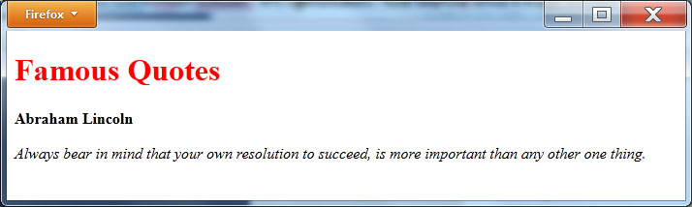
Reviewing inline styles
<!DOCTYPE html> <body> <h1 style="color:red">Famous Quotes</h1> <p style="font-weight:bold">Abraham Lincoln</p> <p style="font-style:italic">Always bear in mind that your own resolution to succeed, is more important than any other one thing.</p> </body> </html>

Slide 4
Getting started with CSS classes
Often, there will be times when you will want to display a tag’s contents differently based on the tag’s context or use.
For example, you might want to display your first paragraph with a bold font, a paragraph that contains a quote in italics, and yet other paragraphs in a standard font. In such cases, you can use CSS classes to define the formatting for each “class” of paragraph.
To define a CSS class, you specify a class name, which you define, and the corresponding attributes. You will precede the class name with a period and then place the class attributes within left and right braces:
.classname { attributes here }

Slide 5
Using a class definition
After you define a class, you use the class attribute within a tag to specify the name of the class the attributes of which you want to include. The following statement, for example, uses the class attribute within the <p> tag to apply the styles defined by the quote class:
<p class= “quote”>Text here</p>

Slide 6
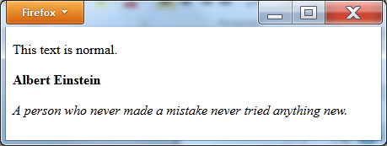
csS Class Demo
<!DOCTYPE html> <head> <style type="text/css"> .bold { font-weight:bold; } .quote { font-style:italic; } </style> </head> <body> <p>This text is normal.</p> <p class="bold">Albert Einstein</p> <p class="quote">A person who never made a mistake never tried anything new.</p> </body> </html>

Slide 7
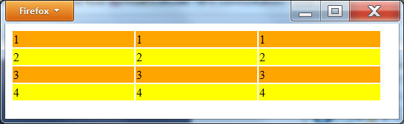
Styling a table
<!DOCTYPE html> <head> <style type="text/css"> .odd { background-color:orange; } .even { background-color:yellow; } </style> </head> <body> <table width="500"> <tr class="odd"><td>1</td><td>1</td><td>1</td></tr> <tr class="even"><td>2</td><td>2</td><td>2</td></tr> <tr class="odd"><td>3</td><td>3</td><td>3</td></tr> <tr class="even"><td>4</td><td>4</td><td>4</td></tr> </table> </body> </html>

Slide 8
Assigning definitions to multiple selectors
Often, as you format a page, you will use the same attributes for many elements, such as font or color:
h1 { font-family:arial; color:blue; } h2 { font-family:arial; color:blue; } p { font-family:arial; color:blue; }
In such cases, you can specify the tag selectors on one line, as shown here:
h1, h2, p { font-family:arial; color:blue; }

Slide 9
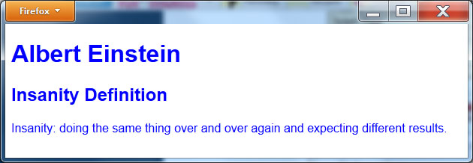
Shared attributes
<!DOCTYPE html> <head> <style type="text/css"> h1, h2, p { font-family:arial; color:blue; } </style> </head> <body> <h1>Albert Einstein</h1> <h2>Insanity Definition</h2> <p>Insanity: doing the same thing over and over again and expecting different results.</p> </body> </html>

Slide 10
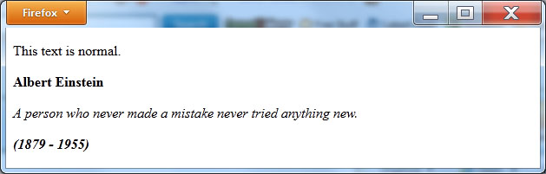
Using multiple class definitions
<!DOCTYPE html> <head> <style type="text/css"> .bold { font-weight:bold; } .quote { font-style:italic; } </style> </head> <body> <p>This text is normal.</p> <p class="bold">Albert Einstein</p> <p class="quote">A person who never made a mistake never tried anything new.</p> <p class="quote bold">(1879 - 1955)</p> </body> </html>

Slide 11
Using class names
As you format a page, there may be times when you will want to define specific classes which use a meaningful name, such as center, but which require different attribute settings. For example, you may want to use a class named center which would requires different attributes for text and an image. In such cases, you can define class specific attributes:
<style type="text/css"> .center { text-align:center; } img.center { display:block; margin-left:auto; margin-right:auto; } </style>
The first class definition is generic in that it does not specify a selector. The second class definition, however, img.center, will apply only to the <img> tag.

Slide 12
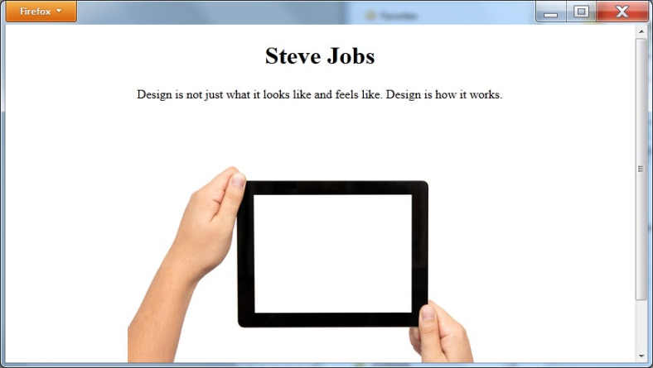
Class name demo
<!DOCTYPE html> <head> <style type="text/css"> .center { text-align:center; } img.center { display:block; margin-left:auto; margin-right:auto; } </style> </head> <body> <h1 class="center">Steve Jobs</h1> <p class="center">Design is not just what it looks like and feels like. Design is how it works. </p> <img class="center" src="http://www.websitedevelopmentbook.com/chapter08/apple.jpg" /> </body> </html>

Slide 13
Using most attributes
In a similar way, there may be times when you want to use most of the attributes defined in a class, but not all. For example, the following statements define a class named SiteFont which sets the font family, color, and alignment:
<style type="text/css"> .SiteFont { font-family:arial; color:blue; text-align:left; } </style>
Assume, however, that you want paragraph text to appear in red. To do so, you can modify the class definition specifically for the <p> element, changing or adding definitions, while leaving the remaining class attributes unchanged:
<style type="text/css"> .SiteFont { font-family:arial; color:blue; text-align:left; } p.SiteFont { color:red; } </style>

Slide 14
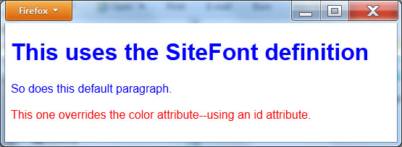
Changing paragraph attribute
<!DOCTYPE html> <head> <style type="text/css"> .SiteFont { font-family:arial; color:blue; text-align:left; } p.SiteFont { color:red; } </style> </head> <body class="SiteFont"> <h1>This uses the SiteFont defition</h1> <p>So does this default paragraph.</p> <p class="SiteFont">This one overrides the color attribute.</p> </body> </html>

Slide 15
ID-based styles
Most HTML tags support an id attribute that lets you associate a name with a specific element within your page:
<h1 id=“SiteTitle”>The heading content</h1> <p id=“Main”>The paragraph content</p>
Just as CSS lets you define attributes for specific tags, it also lets you define attributes for a specific element id. To do so, you specify the id following a pound sign (#), as shown here:
#idName { style definition }
Defining an id-based selector is similar to defining a class. However, unlike a class which you can apply to multiple tags or elements, the id-based selector is specific to one element within your page.

Slide 16
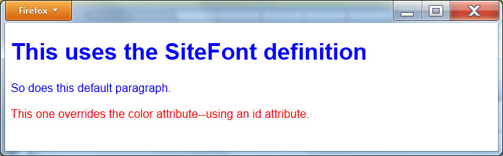
Id-based style demo
<!DOCTYPE html> <head> <style type="text/css"> .SiteFont { font-family:arial; color:blue; text-align:left; } #LastParagraph { color:red; } </style> </head> <body class="SiteFont"> <h1>This uses the SiteFont defition</h1> <p>So does this default paragraph.</p> <p id="LastParagraph">This one overrides the color attribute--using an id attribute.</p> </body> </html>

Slide 17
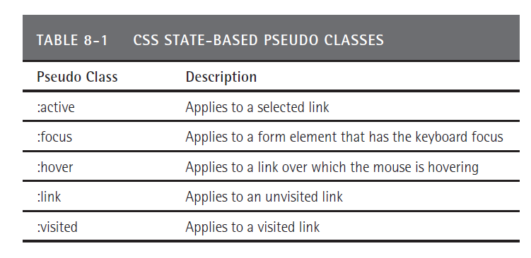
Pseudo classes

Slide 18
Pseduo-class demo
<!DOCTYPE html> <head> <style type="text/css"> a:hover{ background-color:yellow; } a:visited { background-color:red; } a:selected { background-color:blue; } a:link { background-color:orange; } </style> </head> <body> <a href="http://www.theheadoftheclass.com">Head of the Class</a> </body> </html>

Slide 19
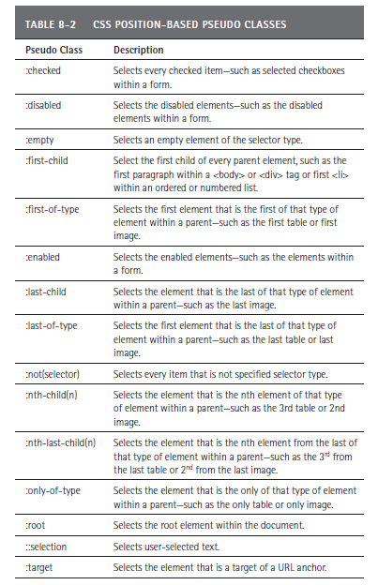
Additional pseudo classes

Slide 20
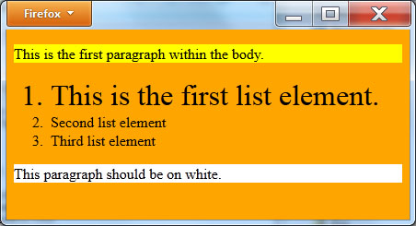
Pseudo-class demo
<!DOCTYPE html> <head> <style type="text/css"> p:first-child { background-color: yellow; } p { background-color:white; } :not(p) { background-color: orange } li:first-of-type { font-size:200%; } </style> </head> <body> <p>This is the first paragraph within the body.</p> <ol> <li>This is the first list element.</li> <li>Second list element</li> <li>Third list element</li> </ol> <p>This paragraph should be on white.</p> </body> </html>

Slide 21
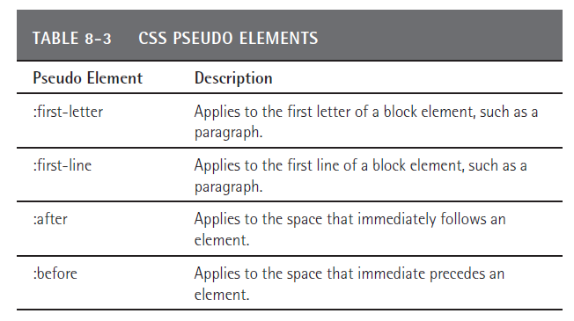
Css pseudo elements

Slide 22

demo
<!DOCTYPE html> <head> <style type="text/css"> p:first-letter { font-size:300%; color:Blue; } </style> </head> <body> <p>Imagination is more important than knowledge.</p> <p>Albert Einstein</p> </body> </html>

Slide 23

Real world – certification process

Slide 24
summary
Across the Web, developers make extensive use of cascading style sheets to format the appearance of objects within an HTML page.
You can create CSS class definitions which you can then apply to specific HTML tags using each tag’s class attribute.
You can define selector-specific classes and id-based classes.
CSS defines pseudo classes which correspond to an object’s state or position, such as having the mouse over the object, or the object being the first element in a list.

